Slide 1
Docker Step by Step…

Slide 2
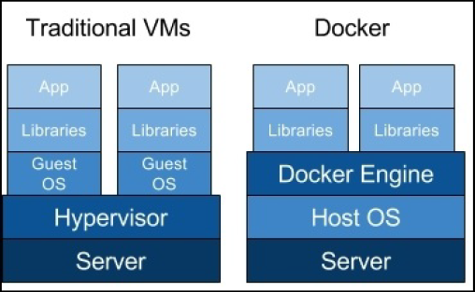
Why do we use a OS Base Image with Docker if containers have no Guest OS?
Since all Linux distributions run the same (yup, it's a bit simplified) Linux kernel and differ only in userland software, it's pretty easy to simulate a different distribution environment - by just installing that userland software and pretending it's another distribution. Being specific, installing CentOS container inside Ubuntu OS will mean that you will get the userland from CentOS, while still running the same kernel, not even another kernel instance.
So lightweight virtualization is like having isolated compartments within same OS. Au contraire real virtualization is having another full-fledged OS inside host OS. That's why docker cannot run FreeBSD or Windows inside Linux.
If that would be easier, you can think docker is kind of very sophisticated and advanced chroot environment.

Slide 3
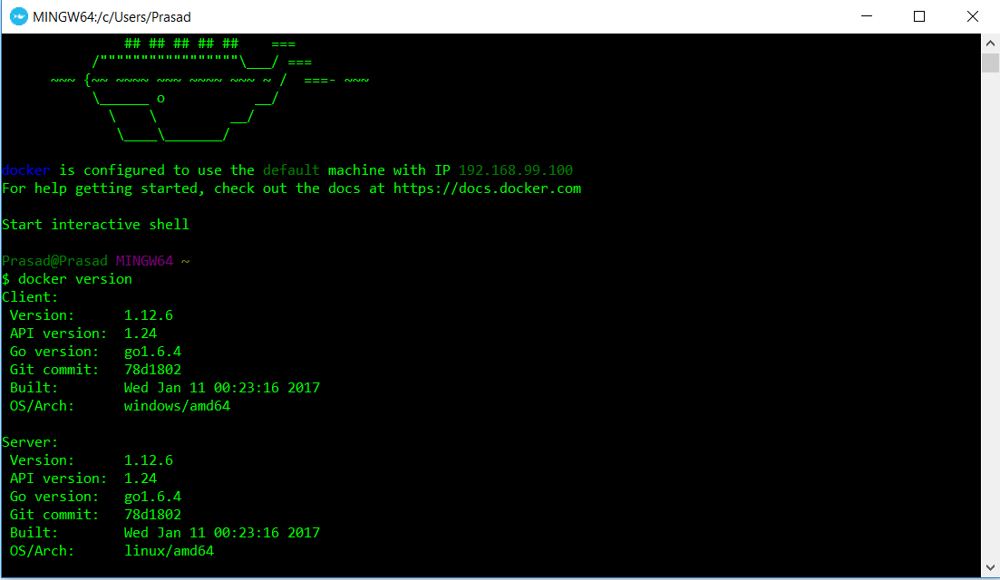
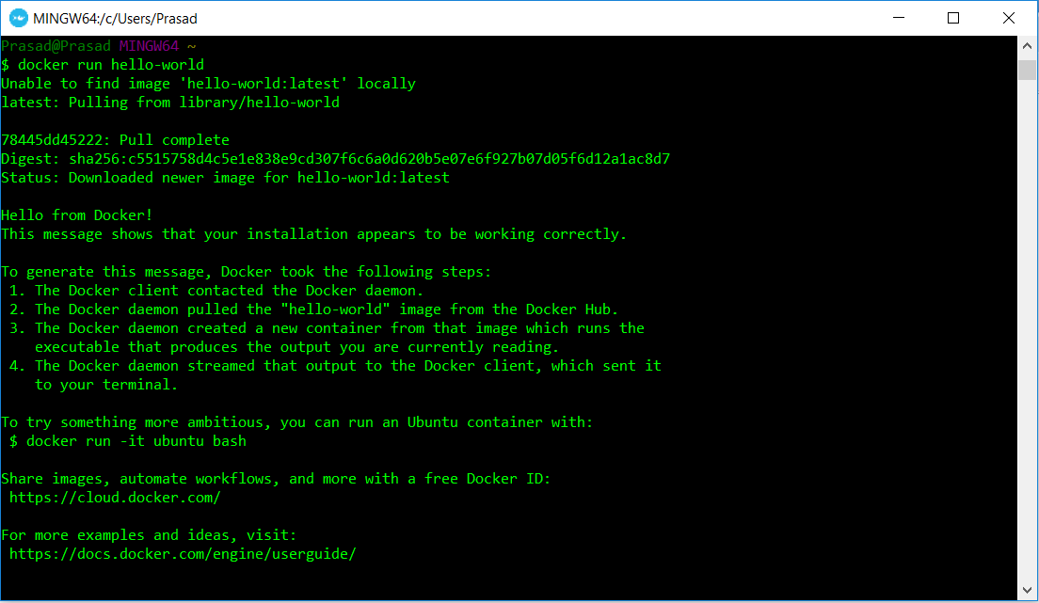
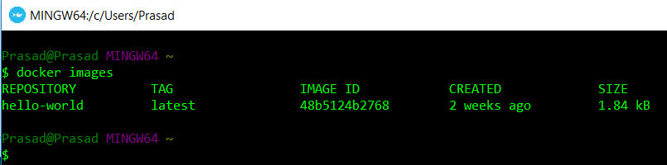
https://docs.docker.com/engine/reference/commandline/docker/
Description | Docker Commands
Check the docker version | docker version
Docker run command | docker run hello-world
List all docker images | docker images

Slide 4
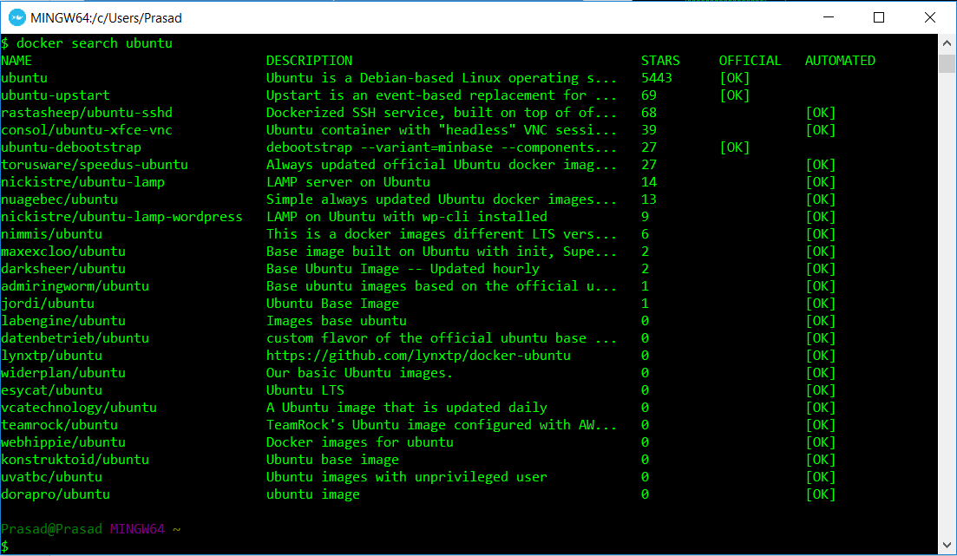
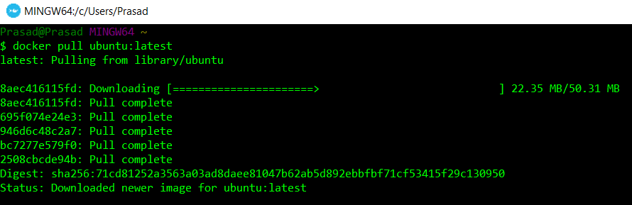
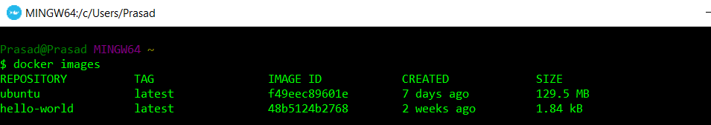
Description | Docker Commands
Searching for docker images | docker search Ubuntu
Download an image | docker pull ubuntu:latest

Slide 5
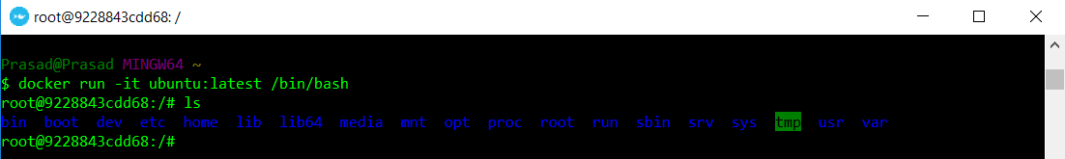
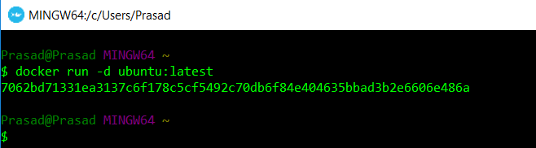
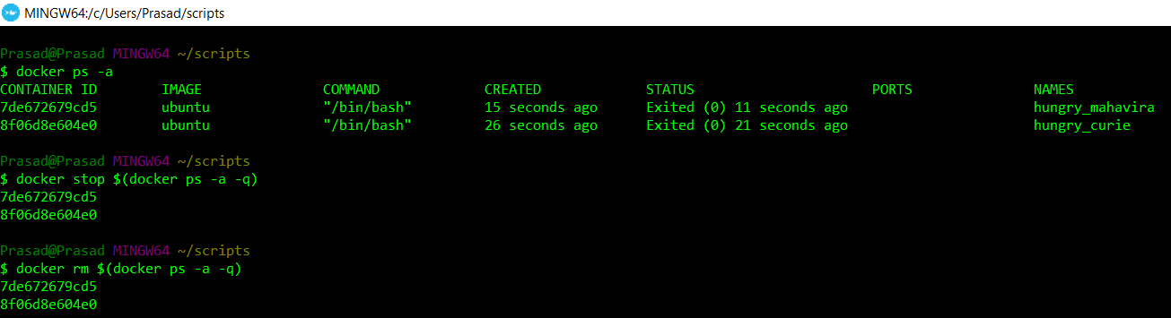
Description | Docker Commands
Run the container in interactive mode | docker run -i -t <image_name>:<tag> /bin/bash
Run the container in daemon/detach mode | docker run -d <image_name>:<tag>
List all running and stopped containers | docker ps docker ps -a
Stop & remove all docker containers | docker stop $(docker ps -a -q) docker rm $(docker ps -a -q)

